Slide 1
Ict Ganpat university
PROJECT WORK ON AADHAR ATTENDANCE SYSTEM.

Slide 2
HEY GUYS, WELL THIS IS MAHIL OF ICT GANPAT UNIVERSITY OF SEMESTER 01 BRANCH CLOUD BAED APPLICATIONS ENROLLMENT NUMBER: CBA 21 AND TODAY I AM HERE TO SHOW YOU MY PRESENTATION AND PROJECT WORK ON A VERY COMMON BUT IMPORTANT TOPIC OF AADHAR ATTENDANCE SYSTEM.

Slide 3
IN THIS PROJECT :
HERE IN THIS PRESENTATION AT FIRST I AM GOING TO TELL YOU A MORE LITTLE AADHAR ATTENDANCE SYSTEM.
AFTER THAT IN THIS PRESENTATION I AM GOING TO TELL YOU ABOUT THE FACTORS OF AADHAR ATTENDANCE SYSTEM.
AND THEN IN THIS PRESENTATION I AM GOING TO SHOW YOU THE KEY FEATURES OF AADHAR ATTENDANCE SYSTEM.

Slide 4
IN THIS PROJECT :
AFTER THAT THIS PRESENTATION WILL TELL YOU ABOUT THE ADVANTAGES OF STUDENT LIFE CYCLE MANAGEMENT SYSTEM.
AND THEN I WILL TELL YOU ABOUT MY WEBSITE WHICH I MADE USING C LANGUAGE .
I WILL ATTACH SCRRENSHOT OF BOTH CODES AS WELL AS OUTPUTS IN THIS PRESENTATION .
AND AT EVERY SLIDE OF THIS PRESENTATION I WILL TELL YOU WHAT THIS WILL DO AND WHAT IF WE HAVE PUT WRONG USERNAME AND OUTPUTS.
AND ATLAST THE PROJECT ENDS.

Slide 5
CONCEPTS USED IN THIS PROJECT:
I MADE THIS PROJECT BY USING THE CONCEPTS OF C LANGUAGE INCLUDING POINTERS, ARRAY, FILE HANDLING,AND LOOP,ANIMATION.

Slide 6
COMPILER USED :
I USED CODEBLOCK COMPILER TO RUN THE CODE.

Slide 7
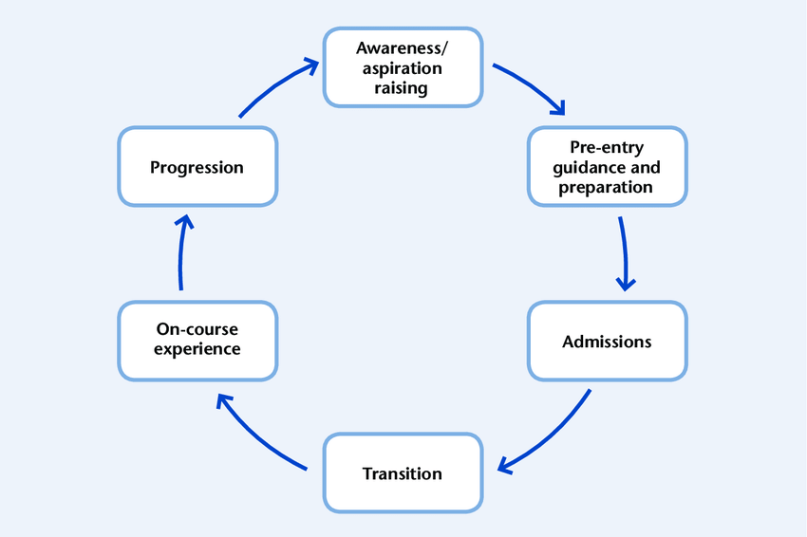
FLOWCHART OF STUDENT LIFE CYCLE MANAGEMENT SYSTEM

Slide 8
AADHAR ATTENDANCE SYSTEM
“AADHAR ATTENDANCE SYSTEM IS A DATA-DRIVEN AND HOSLISTIC APPROACH THAT FOCUSES ON ENTIRE STUDENT JOURNEY RIGHT FROM THE INQUIRY FOR ADMISSION TO ALUMNI TO ENSURE STUDENT SUCCESS IN REAL-TIME.”
“AADHAR ATTENDANCE SYSTEM CAN ENABLE US TO MANAGE AND CREATE QUICKLY & EASY TO-USE STUDENT PROFILE INFORMATION, THE INQUIRY PROCESS, ENROLLMENT FOR ADMISSION LINK TO ENROLL, SCHEDULDE, TRANSCRIPT, AND DEGREE EVALUATION, AND SHARE RECORDS WITH FACULTIES, AND ADMINSTRATIONS.”

Slide 9
FACTORS OF STUDENT LIFE CYCLE MANAGEMENT SYSTEM :
INQUIRY FOR ADMISSION
STUDEND ID
SEARCH ID
GENERATE MARKSHIT
DELETE AACCOUNT
CHANGE ID AND DETAILS
GENERATE MARKSHIT
EXIT

Slide 10
ABOUT THE WEBSITE

Slide 11
LOGIN PAGE:
ABOUT LOGIN PAGE :
HERE, AT FIRST SCHOOLS WILL USERNAME AND PASSWORD TO STUDENTS. WHEN STUDENT ENTER THEIR CORRECT USERNAME AND PASSWORD THEN IT WILL SHOW LOGIN SUCCESSFULLY AND THEN NEXT PAGE WILL OPEN. AND IF WE ENTER INCORRECT USERNAME OR PASSWORD THE PAGE SHOW YOU HAVE ENTER INCORRECT USERNAME OR PASSWORD.

